Slide 1
IT Professional Environment: Law, Ethics and Privacy
Week 9:
Lecturer: Dr. Farshid Keivanian

Slide 2
Information Age and Privacy
Introduction:
The Information Age has led to the mass collection and sharing of personal data across digital networks. This has raised significant concerns over who controls this data and how it is protected.

Slide 3
Information Age and Privacy
Practical Scenario:
You are part of a software development team at the Commonwealth Bank of Australia. The bank is creating a new mobile app that will collect user data, including their location, passwords, and financial details.
Open-Ended Discussion Question:
How would you ensure that Commonwealth Bank protects user data in compliance with privacy standards?

Slide 4
Information Age and Privacy
Responses:
Implement encryption and strong password policies.
Ensure the app requests user consent for accessing sensitive data.
Comply with the Australian Privacy Act to safeguard personal information.
Multiple-Choice Question:
Which regulation most significantly impacts the handling of personal data in Australia?
Australian Privacy Act 1988
GDPR
CCPA
Freedom of Information Act

Slide 5
Privacy Issues and Protection
Introduction:
Privacy concerns are associated with data ownership, data risks, and the protection of personal information. These issues become increasingly complex in a globalized digital environment.

Slide 6
Privacy Issues and Protection
Practical Scenario:
You work for Telstra in Melbourne, which collects extensive customer data. You're tasked with ensuring that the collected data is protected and that customers have control over their personal information.
Open-Ended Discussion Question:
What measures would you take to protect Telstra’s customer data from privacy breaches?

Slide 7
Privacy Issues and Protection
Responses:
Implement data encryption and access controls.
Educate customers about their rights to access and edit their data.
Develop a comprehensive privacy policy in compliance with the Australian Privacy Act.

Slide 8
Privacy Issues and Protection
Follow-Up Question:
How would you communicate a data breach to Telstra customers to ensure transparency?

Slide 9
World Law and Australian Privacy ACT
Introduction:
Various countries have different privacy laws, but Australia’s Privacy Act 1988 provides a comprehensive framework for managing personal data in businesses and government agencies.

Slide 10
World Law and Australian Privacy ACT
Practical Scenario:
As the Chief Privacy Officer at Atlassian in Sydney, you're responsible for ensuring compliance with both international and local privacy laws. A European client raises concerns about GDPR compliance in a new project.
Open-Ended Discussion Question:
How would you ensure that Atlassian’s privacy policies are compliant with both GDPR and the Australian Privacy Act?

Slide 11
World Law and Australian Privacy ACT
Responses:
Ensure clear consent mechanisms are in place for all clients.
Implement data protection measures that meet GDPR and Australian requirements.
Regularly audit data handling practices to ensure compliance.
Multiple-Choice Question:
What is the main privacy law governing data protection in Australia?
Australian Privacy Act 1988
GDPR
CCPA
FOI Act 1982

Slide 12
Real Scenario of Privacy
Introduction:
Real-life privacy breaches often occur when organizations fail to safeguard sensitive personal information. Data breaches can result in significant financial and reputational damage

Slide 13
Real Scenario of Privacy
Practical Scenario:
Woolworths recently suffered a data breach exposing thousands of customer credit card details. You are responsible for managing the company’s response to the breach.
Open-Ended Discussion Question:
What steps would you take to manage and mitigate the impact of the data breach at Woolworths?

Slide 14
Real Scenario of Privacy
Responses:
Notify the affected customers immediately.
Work with cybersecurity professionals to secure the breached systems.
Review and strengthen data protection policies to prevent future breaches.

Slide 15
Ethics of Privacy
Introduction:
Privacy isn't just a legal issue—it’s also an ethical one. Companies must navigate the fine line between leveraging personal data for business insights and respecting customer privacy.

Slide 16
Ethics of Privacy
Practical Scenario:
As a manager at Australia Post, you discover that personal customer data has been shared without their consent. You must address this breach in a way that upholds ethical standards.
Open-Ended Discussion Question:
How would you ethically handle the privacy breach at Australia Post, and what actions would you take to prevent future ethical lapses?

Slide 17
Ethics of Privacy
Responses:
Apologize to the affected customers and offer support in resolving issues.
Ensure that future data-sharing policies are transparent and ethical.
Provide regular ethics training to employees on privacy issues.

Slide 18
Interactive Group Class Activity: Calibri Font 28 – F.Keivanian@aapoly.edu.au
Design a Privacy Policy: Each group will be assigned an Australian company (e.g., Qantas, Westpac, Woolworths) and tasked with drafting a comprehensive privacy policy, ensuring compliance with Australian and international privacy laws.
Role-Playing Scenario: Groups can act as the privacy officers responding to a data breach, presenting their strategies to secure data and restore public trust.

Slide 19
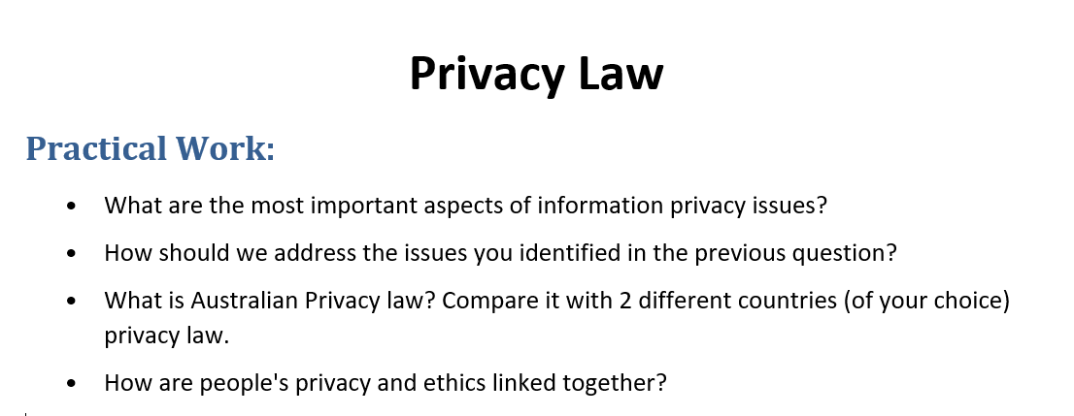
Tutorial Week 9: Individual Class Activity

